Slide 1
Software Requirement Engineering
Software Verification & Validation
Muhammad Nasir
m.nasir@iiu.edu.pk

Slide 2
Outline
Why Test?
System verification
System validation
Techniques for V&V

Slide 3
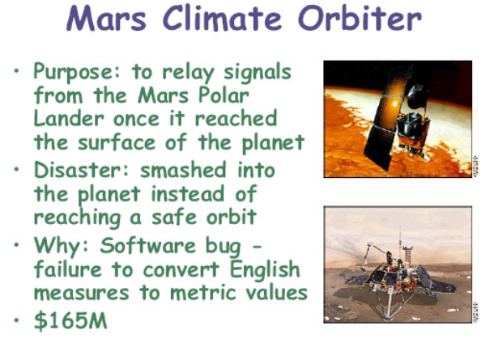
Why Test?

Slide 4
Software is buggy !
On average, 1-5 errors per 1KLOC
Windows 2000
– 35M LOC
– 63,000 known bugs at the time of release
– 2 bugs per 1000 lines
For mass market 100% correct software is infeasible,
But we must verify software as much as possible

Slide 5
System Verification
Verification:
“Are we building the product right”
The software should conform to its specification
Does our design meet the spec?
Does our implementation meet the spec?
Are our requirements models consistent with one another?

Slide 6
System Validation
Validation:
“Are we building the right product”
The software should do what the user really requires
Does our problem statement accurately capture the real problem?
Did we account for the needs of all the stakeholders?

Slide 7
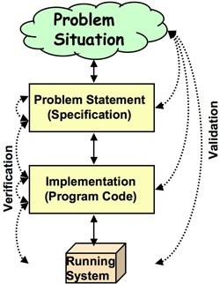
Verification & Validation

Slide 8
Verification & Validation
Help ensure delivery of what the client wants
Need to be performed at every stage during the (requirements) process
Elicitation
  Checking back with the elicitation sources
  “So, are you saying that . . . . . ?”
Analysis
  Checking that the domain description and requirements are correct
Specification
  Checking that the defined system requirement will meet the user
  Checking requirements under the assumptions of the domain/environment
  Checking conformity to rules, standards…

Slide 9
V & V Techniques
Simple checks
Traceability
Prototyping
Functional test design
User manual development
Reviews and inspections

Slide 10
Simple Checks & Traceability Matrix
Various checks can be done using traceability techniques
  Given the requirements document, verify that all elicitation notes are covered
  Tracing between different levels of requirements
    Checking goals against tasks, features, requirements…
Involves developing a traceability matrix
  Ensures that requirements have been taken into consideration (if not there should be a reason)
  Ensures that everything in the specification is justified

Slide 11
Prototyping
“A software prototype is a partial implementation constructed primarily to enable customers, users, or developers to learn more about a problem or its solution.” [Davis 1990]
“Prototyping is the process of building a working model of the system” [Agresti 1986]

Slide 12
Prototyping
Excellent for validation by users and customers
  More accessible than specification
  Demonstrate the requirements and help stakeholders discover problems

Slide 13
Functional Testing
Can reveal the presence of errors NOT their absence
Each (functional) requirement should have an associated test and must be traced to its requirements
Inventing requirements tests is an effective validation technique
Designing these tests may reveal errors in the specification (even before designing and building the system)!

Slide 14
Functional Testing
Missing or ambiguous information in the requirements description may make it difficult to formulate tests
Non-functional (e.g., reliability) or exclusive (e.g., define what should not happen) requirements are harder to validate with testing

Slide 15
Types of testing
Defect testing
Tests designed to discover system defects
A successful defect test is one which reveals the presence of defects in a system
Validation testing
Intended to show that the software meets its requirements

Slide 16
Testing and debugging
What is the difference between these two?
Defect testing and debugging are distinct processes
Verification and validation is concerned with establishing the existence of defects in a program
Debugging is concerned with locating and repairing these errors
Debugging involves formulating a hypothesis about program behavior then testing these hypotheses to find the system error

Slide 17
Requirements Review and Inspection
A group of people read and analyze requirements, look for potential problems, meet to discuss the problems, and agree on a list of action items needed to address these problems
A widely used requirements validation technique
  Lots of evidence of effectiveness of the technique
Can be expensive
  Careful planning and preparation
  Pre-review checking
  Need appropriate checklists (must be developed if necessary and maintained)

Slide 18
Typical Review Inspection
Reviews should involve several stakeholders drawn from different backgrounds
  People from different backgrounds bring different skills and knowledge to the review
  Stakeholders feel involved in the RE process and develop an understanding of the needs of other stakeholders
  Review team should always involve at least a domain expert and a User

Slide 19
Typical Review Inspection steps
Plan review
  The review team is selected and a time and place for the review meeting is chosen
Distribute documents
  The requirements document is distributed to the review team members

Slide 20
Typical Review Inspection steps
Prepare for review
  Individual reviewers read the requirements to find conflicts, omissions, inconsistencies, deviations from standards, and other problems
Hold review meeting
  Individual comments and problems are discussed and a set of action items to address the problems is established

Slide 21
Typical Review Inspection steps
Follow-up actions
  The review checks that the agreed action items have been carried out
Revise document
  Requirement's document is revised to reflect the agreed action items
  At this stage, it may be accepted, or it may be re-reviewed Introduction

Slide 22
Requirements Review Checklists
Comprehensibility – can readers of the document understand what the requirements mean?
Redundancy – is information unnecessarily repeated in the requirements document?
Completeness – does the checker know of any missing requirements or is there any information missing from individual requirement descriptions?

Slide 23
Requirements Review Checklists
Ambiguity – are the requirements expressed using terms which are clearly defined? Could readers from different backgrounds make different interpretations of the requirements?
Consistency – do the descriptions of different requirements include contradictions? Are there contradictions between individual requirements and overall system requirements?

Slide 24
Requirements Review Checklists
Requirement's clarification
  The requirement may be badly expressed or may have accidentally omitted information which has been collected during requirements elicitation
Missing information
  Some information is missing from the requirements document

Slide 25
Requirements Review Checklists
Requirement's conflict
  There is a significant conflict between requirements
  The stakeholders involved must negotiate to resolve the conflict
Unrealistic requirement
  The requirement does not appear to be implementable with the technology available or given other constraints on the system
  Stakeholders must be consulted to decide how to make the requirement more realistic

Slide 26
The End
Thanks for listening
Questions would be appreciated.

